Slide 1


Module 3: Backend – advanced Workflow Execution
Developing Business Applications with

Slide 2








Browser
Module 3: Backend – advanced (jobs & workflows)
Client
WebSocket
Application Services
HTTP
HTTP
Authorization
Server
Web
Server
Job
Orchestrator
Job
Host(s)
Job
Host(s)
HTTP
Job
Host(s)
HTTP
TCP/IP
TCP/IP
HTTP
HTTP
Infrastructure Services
Azure
PostgreSQL
MIKE Cloud
Services

Slide 3

Purpose of the Workflow - History
Architecture
Workflow Example
Building blocks – Actions
Scenarios
(Ask questions along the way)
Notes:
<use this slide for agenda>

Slide 4

Who Am I
Franz Thomsen - Head of Port IT / Cybersecurity, Seaport OPX
With DHI since 2001 - first operational systems in 2003
Lots of front-ends through multiple tech stacks
Lots of backends through multiple tech stacks, supporting frontend
Backend “async” scenario/workflow systems since 2009
Reusable, Reusable, REUSABLE
Notes:
<use this slide for agenda>

Slide 5
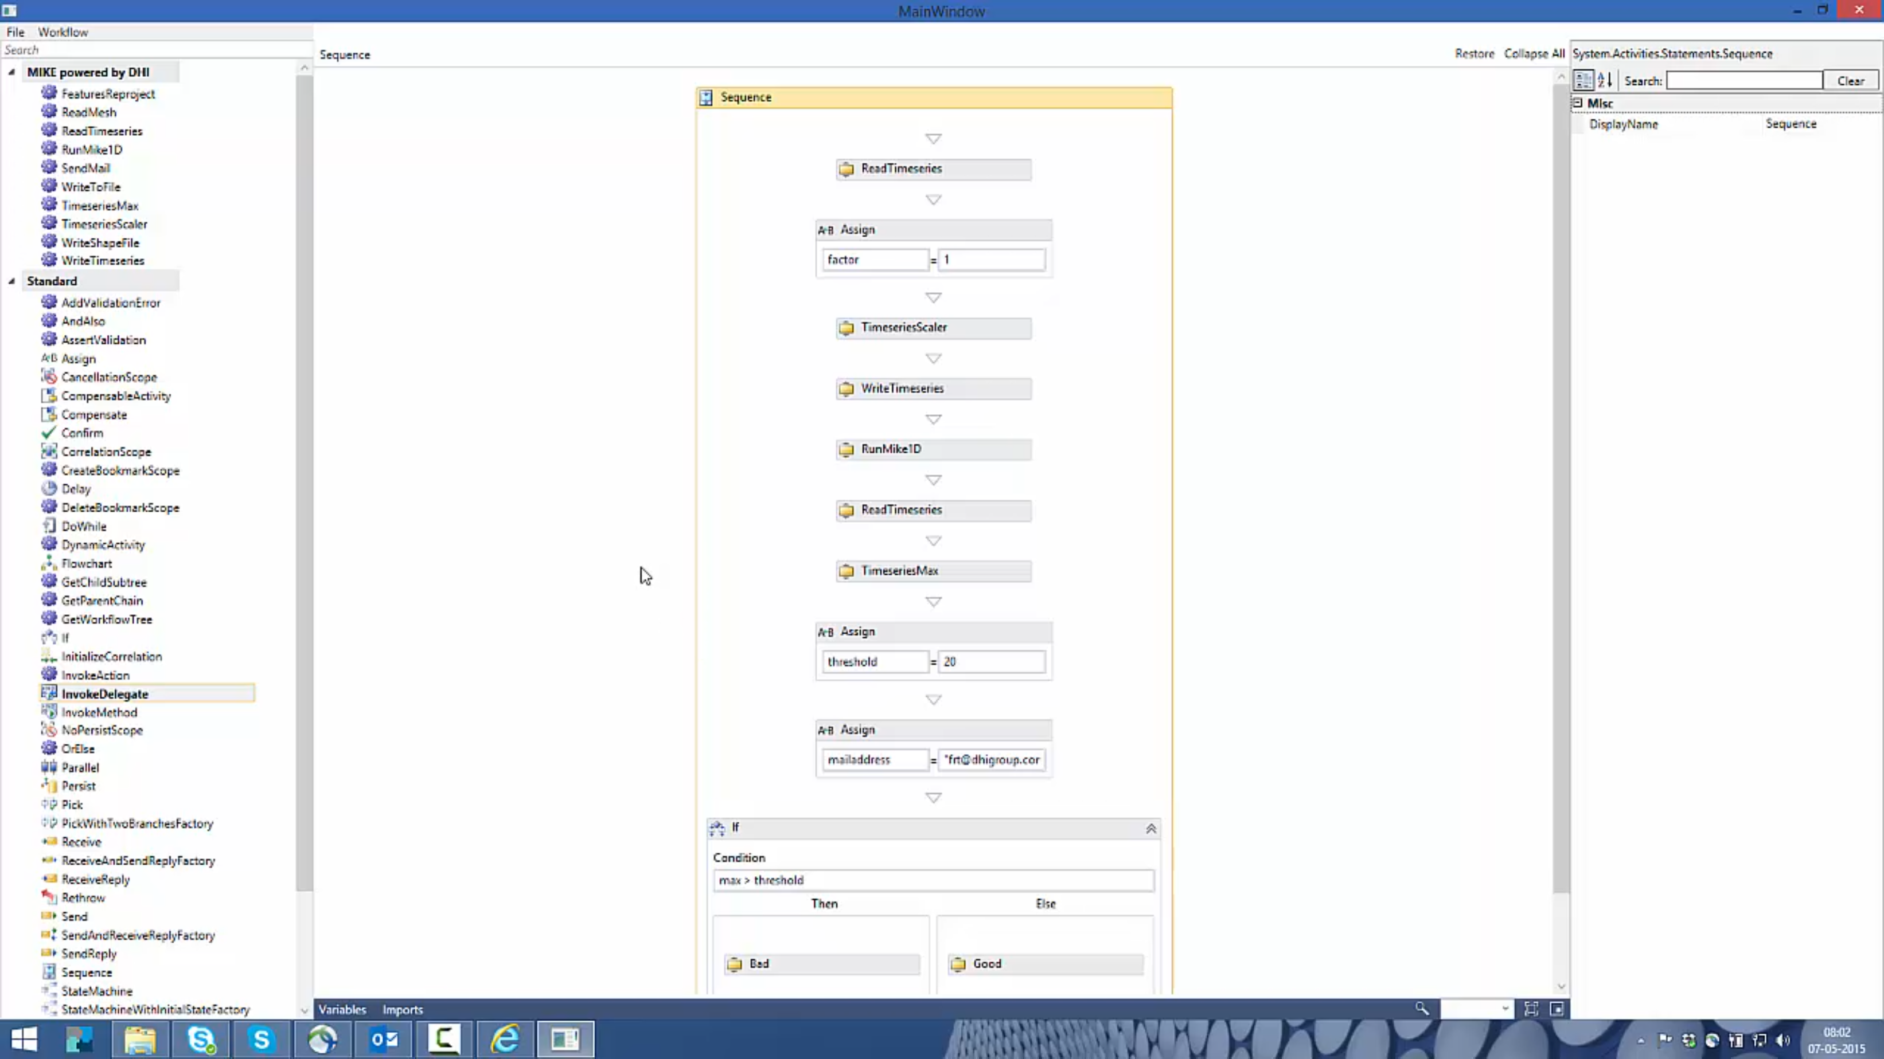
History – 2015 Windows Workflow Foundation is amazing
Reusable building blocks that snaps together through Code Activities
Designer through Windows Workflow Foundation
Xaml based workflows
Domain Services as pillar
Notes:
<use this slide for agenda>

Slide 6
History – 2021 Windows Workflow Foundation is going out, no .net core support
Reusable building blocks that snaps together through Actions (code from Code Activities moved to Actions)
No designer, Visual Studio is used
C# based workflows
(This is where we are now)
Notes:
<use this slide for agenda>

Slide 7
Beyond A designer just makes things very accessible for everyone – ELSA?
Reusable building blocks that snaps together through ELSA Activities wrapping Actions
Web based designer
Json based workflows
Now everyone without software development skills can build workflows again!!
Notes:
<use this slide for agenda>

Slide 8
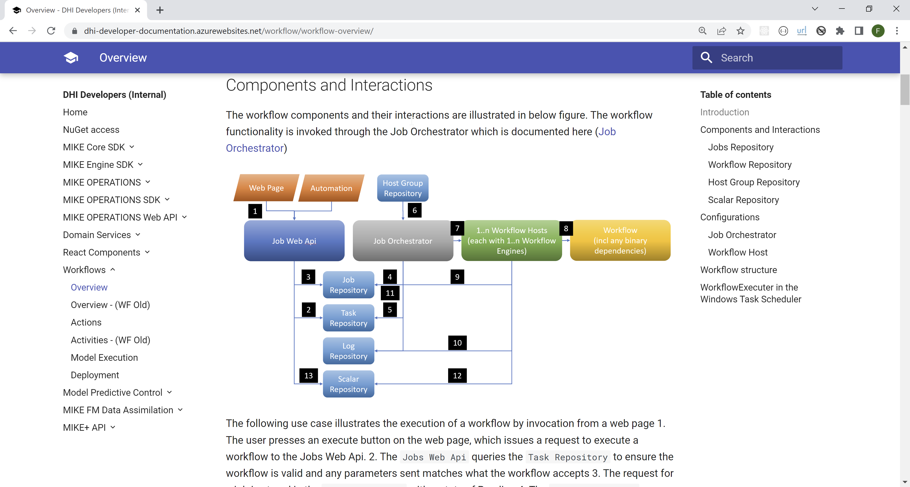
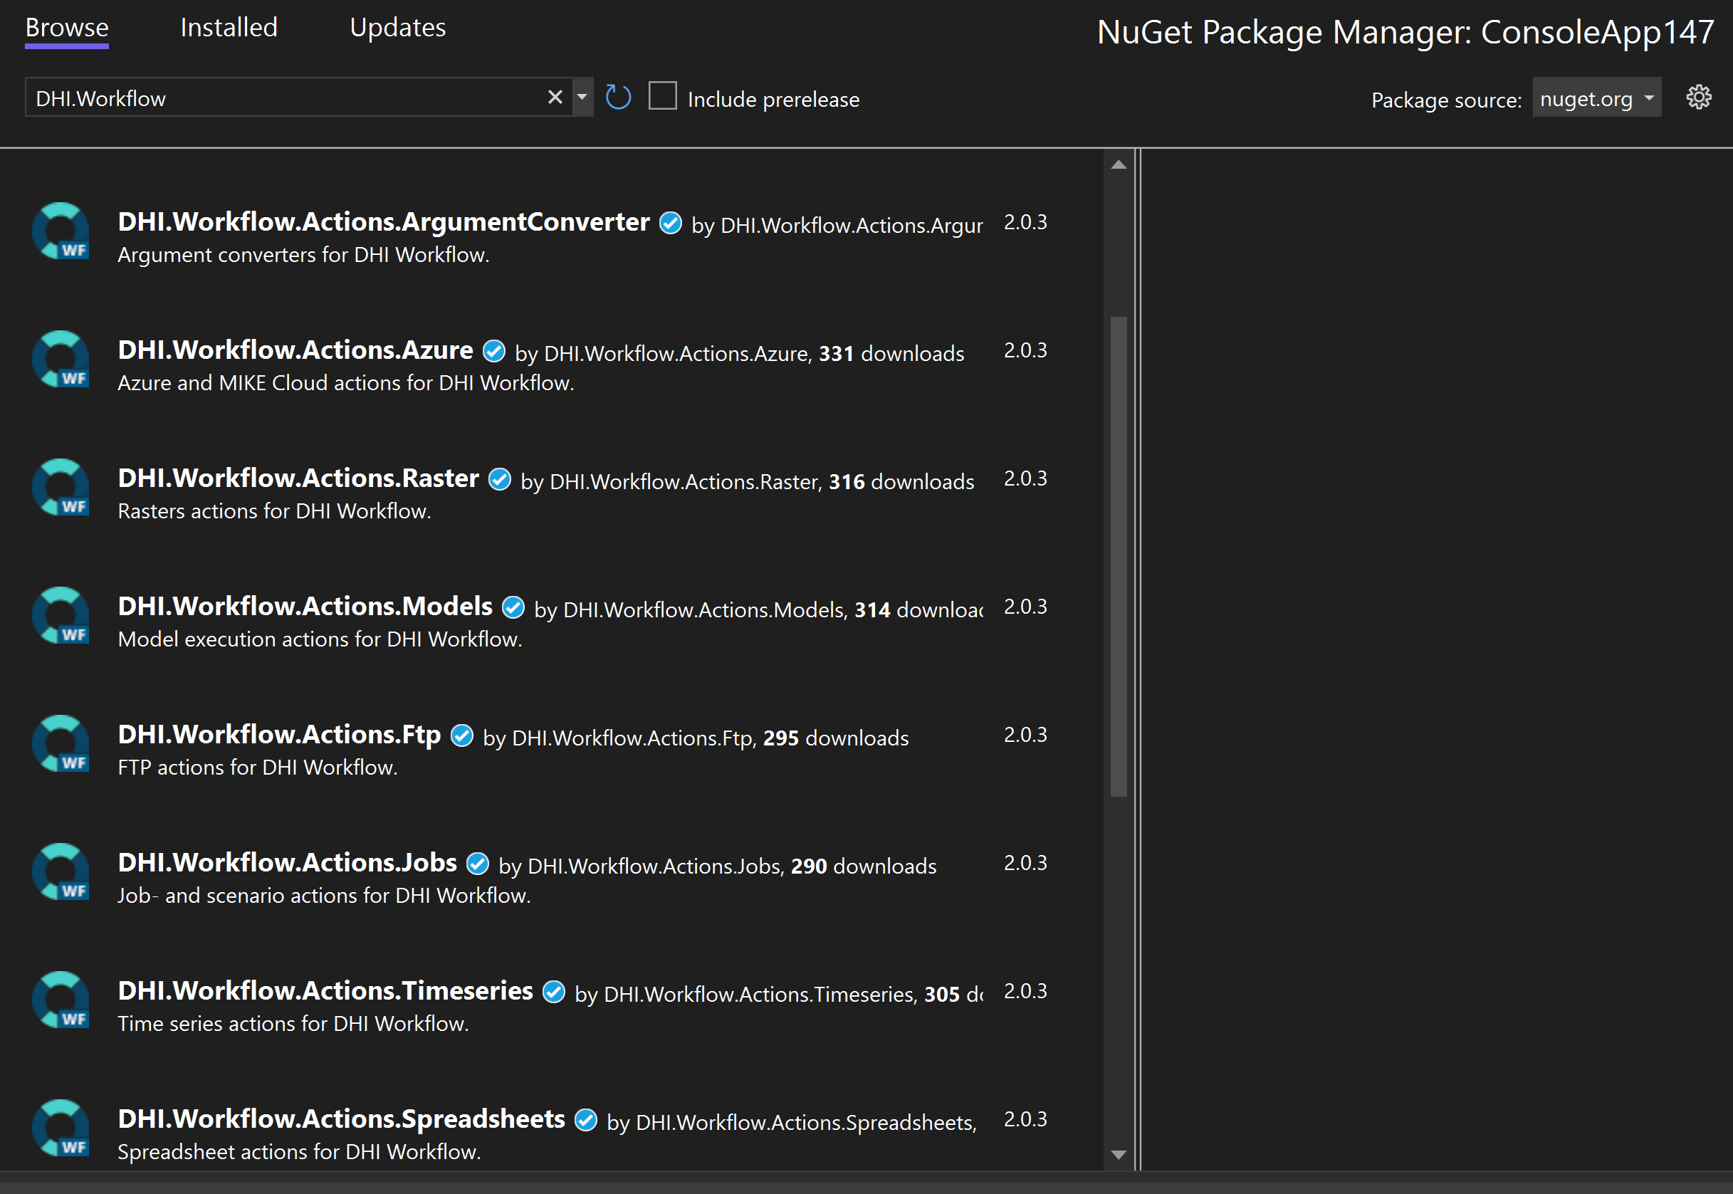
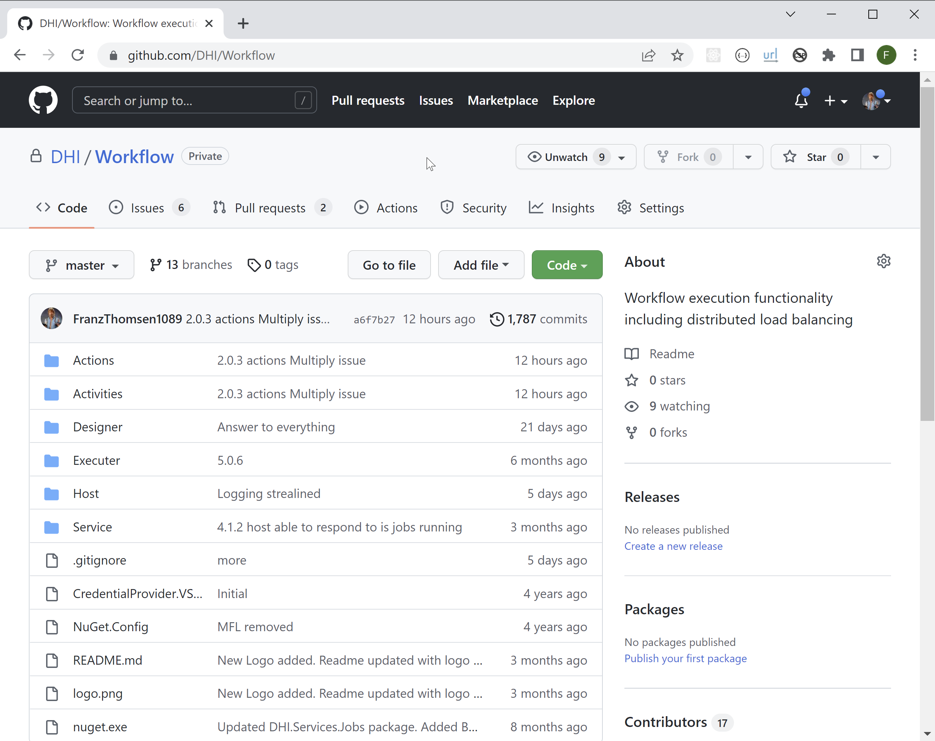
Resources
Developer Documentation
For packages, NuGet
For source, GitHub
Notes:
<use this slide for agenda>

Slide 9
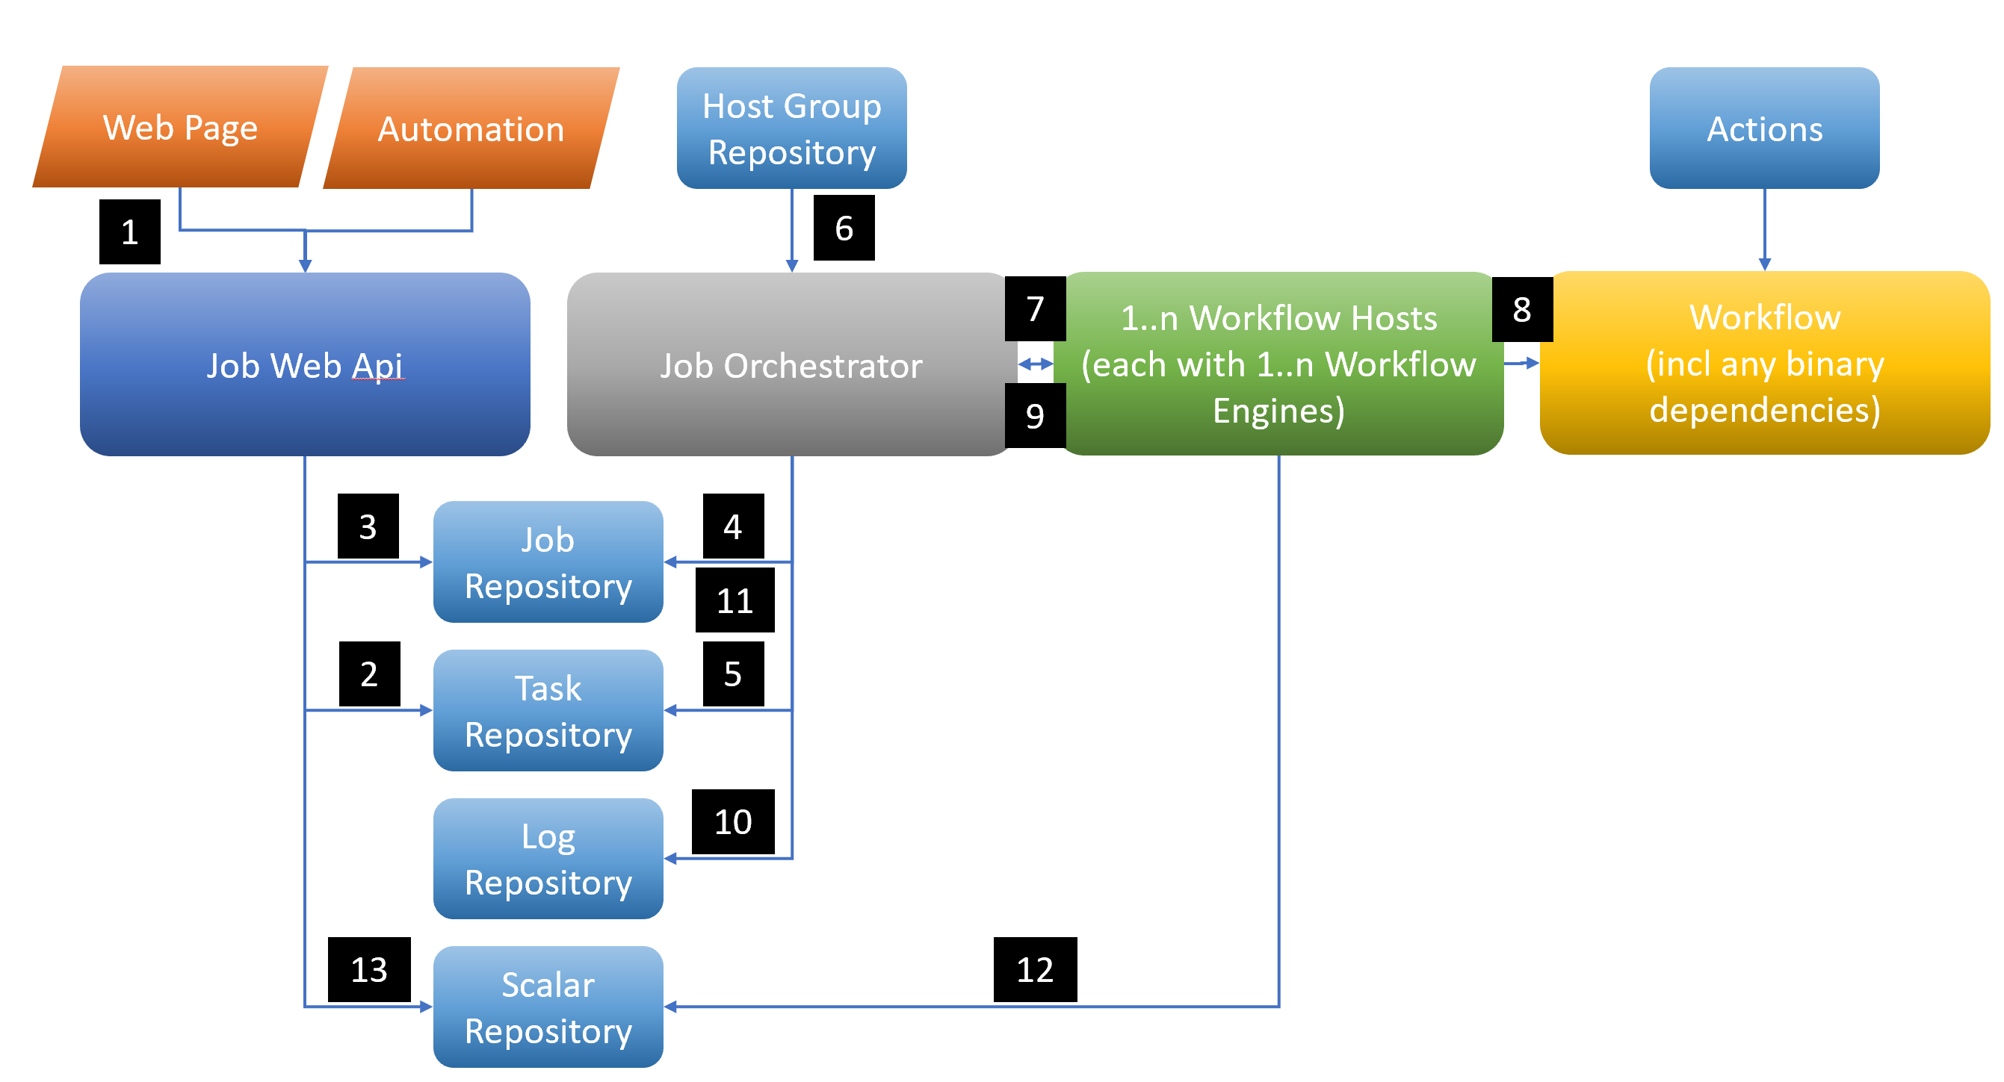
Architecture
Notes:
<use this slide for agenda>

Slide 10
Architecture
Job Repository: Where jobs are tracked with status, completion times etc
Task Repository: The workflows or a representation of these
Log Repository: Where logs go through
Host Group Repository: Registry of hosts to use VMs, ScaleSets, containers
Scalar Repository: A collection of individual values like health flags, other KPIs
Job Orchestrator: The mechanism delegating jobs to execute workflows to available hosts
Workflow Host: The mechanism on the VM, ScaleSets, container that execute the workflow
Workflow: The C# workflow that YOU build
Actions: The prefabs that you can base the Workflow on
Notes:
<use this slide for agenda>

Slide 11
Architecture
Notes:
<use this slide for agenda>

Slide 12
What do I have running for the Demo
Authorisation Server – Local postgres database for users
WebApis – Local file for job repository
JobOrchestratorWinService … Lets see it
WorkflowHostWinService … Lets see it
(Here it’s Windows services, but this is a choice here)
Notes:
Job Orchestrator code
Choices made
Workers, example from NCOS

Slide 13
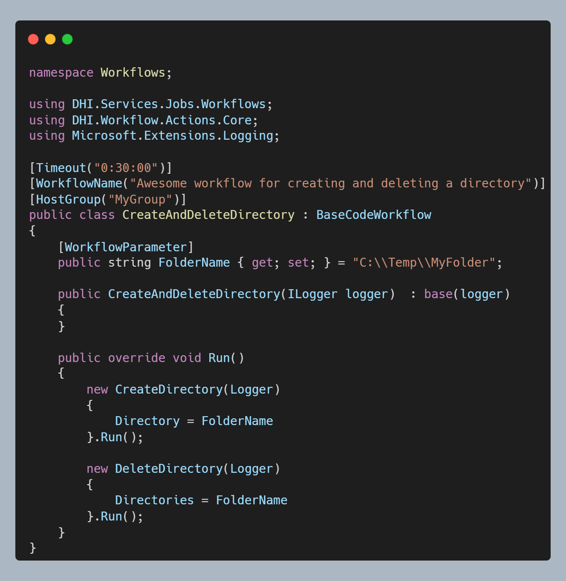
Anatomy of a workflow
Directory.Delete !!! … why Actions???
Comprehensive logging, concurrency management and retry policies needed for operational systems
Workflow timeout, how long is it allowed to run for
Workflow name, for display purpose only so far
HostGroup that the workflow should be executed through *
Parameter exposed e.g. through the web api
Main method called to run workflow
Microsoft ILogger injected
Use of Actions and other wonderful things
Notes:
Job Orchestrator code
Choices made
Workers, example from NCOS

Slide 14
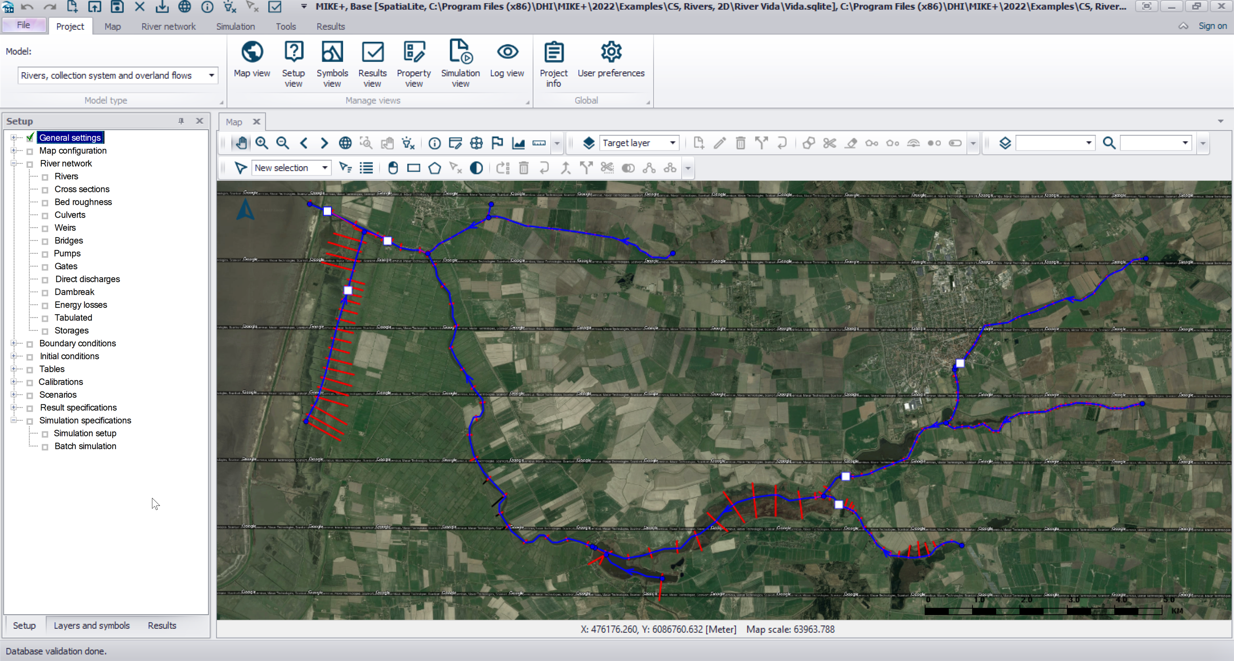
What do I want to Demo
Model technical terms will be used
Run MIKE1D river model in forecast mode
Scale input boundary
Extract result
For the sake of demonstration this example will include aspects that will occur in a forecast system and a scenario system, but probably not in both.
Notes:
<use this slide for agenda>

Slide 15
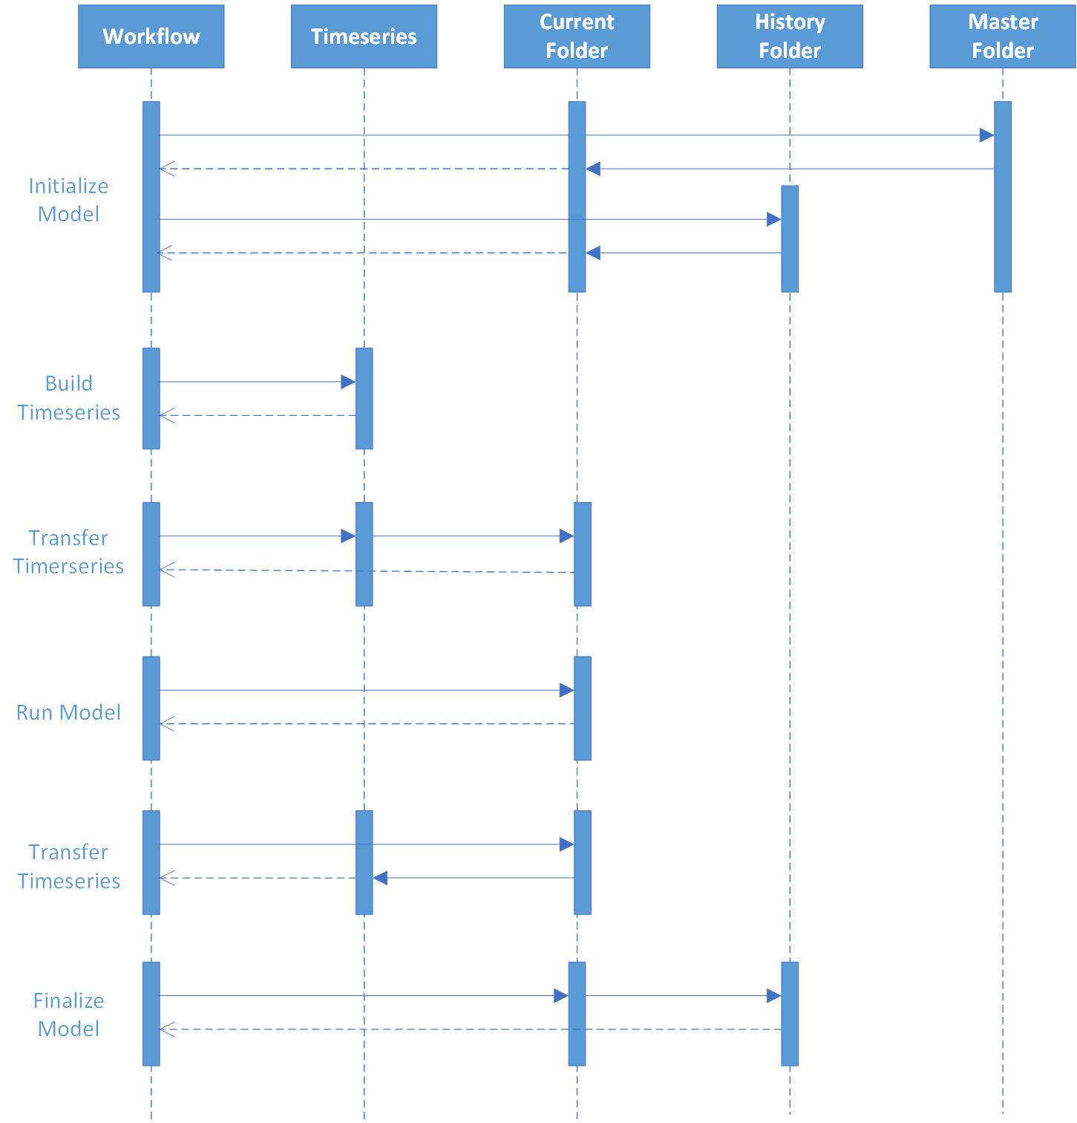
Actions in model execution for this Demo
Current Folder is where the model execution is being performed
History Folder is where previous runs are being archived
Master Folder is where the template model is stored
Documentation

Slide 16
Time series actions – BuildTimeseries
BuildTimeseries
Based on spreadsheet configuration (xlsx/MO/md) where each row defined a time series to be constructed
A time series is constructed based on multiple time series being subjected to multiple methods
A method working on a time series can simple like Offset, Delete, Resample etc to more complex like EstimateWindPeakGust etc
Documentation
Config for this Demo … Lets see it

Slide 17
Time series actions – TransferTimeseries
TransferTimeseries
Based on spreadsheet configuration (xlsx/MO/md) where each row defined a time series to transferred from one repo to another
Documentation and Documentation
Config for this Demo … Lets see it

Slide 18

Let’s see the workflow code
and run the integration test

Slide 19

Let’s see it run from the web api

Slide 20

Notes:
<use this slide for breaks>

Slide 21
Actions – Most important groups
Core – File handling and miscellaneous functionality
Dfs – Dfs manipulation functionality
Ftp – Ftp download functionality
Jobs – Management of workflows, starting workflows, scenarios handling
Models – Model handling and execution
Timeseries – Manipulation, transfer, alerting etc
Documentation
Lets see them

Slide 22
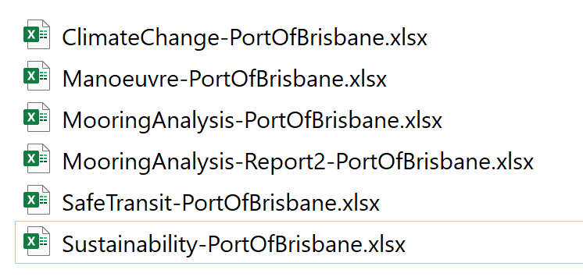
Actions - Extras
NetCDF files
Conversion of NetCDF files has yet to be converted to actions
Based on spreadsheet configuration allowing for separation
Reporting through DHI.Extensions NuGet
Based on spreadsheet templates
Imports Json, Timeseries data, Images
Exports populated pdf, xlsx
Leverages the spreadsheet engine for everything in between

Slide 23
Scenarios - JsonDocuments + Jobs married
User creates a new scenario in a front end (json object), it is stored as a JsonDocument with a unique id
User clicks execute which sends the id through the job request
The workflow uses the id to extract the json object
The workflow uses the json object to e.g. modify models
If data has been added to the json object it is stored again
All along, the front end has been informed through SignalR about changes and progress and the user can now continue working with the executed scenario
Lets see it

Slide 24
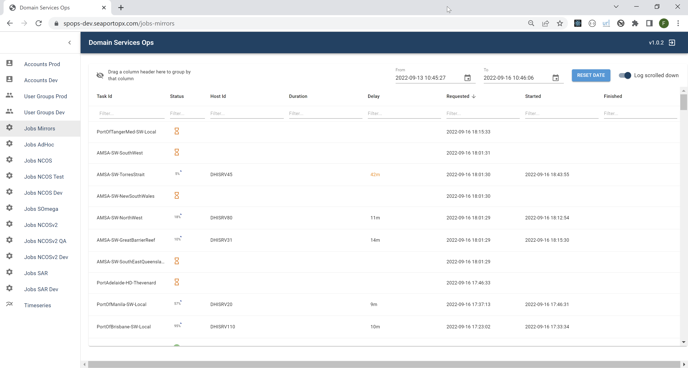
Domain Services Ops
Accounts
User Groups
Jobs
(Timeseries)
(Scalars)
Lets see it

Slide 25
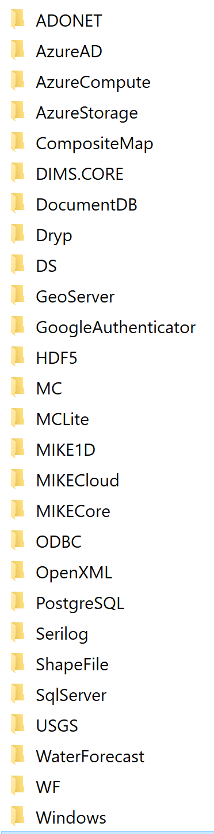
Provider Cheat Sheet - Biased
For local testing there are lots of json based default providers
For production data, use PostgreSQL provider Accounts, UserGroups, RefreshTokens, Jobs, JsonDocuments, Scalars, Logging, Places
For time series, don’t use file based storage for “infinite” times series. Use e.g. MIKE OPERATIONS, MIKE Cloud, DIMS.CORE
For inter process communication, use the DS provider to decouple your system …. (Domain Services provider gives access to Domain Services Webapis)

Slide 26
NCOS

Slide 27
Going forward - Developments
Hybrid Execution option, Azure <-> On Prem/Data Centre
Workflow Host integration with Azure Artefacts
Kubernetes integration
New designer (ELSA), hopefully?
Job Automater, scheduling and event based start of jobs
…
Notes:
<use this slide for agenda>

Slide 28
Internal Open Source
Notes:
<use this slide for agenda>

